Slide 1




EFFICIENT FILE MANAGEMENT & DATA STORAGE IN CLOUD-BASED SYSTEMS USING TREES
PRESENTED BY:
KERMEEN DEBOO S074
&
SWATI MAHAJAN S091

Slide 2
INTRODUCTION
Cloud-based systems are widely used to store large amounts of diverse data, such as text documents, images, and multimedia files.
As the amount of data grows, ensuring efficient storage, fast retrieval, and dynamic updates becomes increasingly important.
Tree data structures, including Huffman Trees, Binary Search Trees (BSTs), B-trees, and Complete Trees, offer efficient ways to solve these challenges in cloud storage systems.

Slide 3
THE PROBLEM OF CLOUD STORAGE
Data Growth: Companies store huge amounts of diverse data.
File Retrieval: Fast file search is key for performance.
Dynamic Updates: Systems need to handle changes (insert/delete files) efficiently.
Storage Optimization: Minimizing space while maintaining fast access is challenging.

Slide 4
EFFICIENT DATA STORAGE (COMPRESSION) USING HUFFMAN TREES
Huffman Trees provide a variable-length encoding scheme.
Complexity:
Time Complexity: O(n log n) for building the tree.
Space Complexity: Reduced due to data compression.

Slide 5
HUFFMAN TREE ALGORITHM
Step1: Start
Step2: Calculate frequencies of each character in data
Step3: create a priority queue
Step4: Extract and combine two minimum frequencies and insert in queue
Step5: Repeat Step 4
Step6: Traverse the Huffman tree to assign binary codes to each character,Move left (0) or right (1) along the tree branches.
Step7: Encode the Data Using Huffman Codes
Step8: End

Slide 6
FILE RETRIEVAL USING BINARY SEARCH TREES (BSTS)
BSTs, specifically self-balancing AVL Trees, store file metadata (name, size, creation date).
Complexity:
Time Complexity: O(log n) for search, insert, and delete.
Space Complexity: O(n), proportional to the number of files

Slide 7
BINARY SEARCH TREE ALGORITHM
Step1: Start
Step2: if search value == current value, return true
Step3: if search value > current value, search in left subtree
Step4: if search value < current value, search in right subtree
Step5: Repeat the above step till no more traversal is possible
Step6: If at any iteration, key is found, return True. Else False.
Step7: End

Slide 8
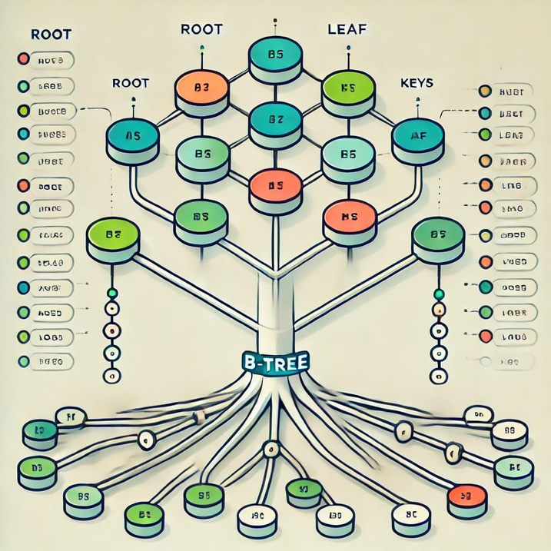
INTRODUCTON B-TREES
B-tree is a self-balancing tree data structure.
Allows logarithmic time for search, insertion, deletion, and sequential access.
Invented by Rudolf Bayer and Ed McCreight in 1972.
Properties :
All leaf nodes are at the same level.
Nodes can have multiple children and keys.
Optimized for disk-based storage due to reduced disk I/O.

Slide 9
DYNAMIC UPDATES WITH B-TREES
B-trees allow efficient management of large data blocks.
Complexity:
Time Complexity: O(log n) for all operations.
Space Complexity: O(n) for storing file metadata.

Slide 10
B-TREE ALGORITHM
Insert File:
Step1: Start
Step2: Starting at the root, find the correct child node to insert the new file
Step3: Insert the file into the leaf node.
Step4: If the leaf node is full, split it into two nodes and move the middle key up to the parent node.
Step5: End

Slide 11
B-TREE ALGORITHM
Delete File:
Step1: Start
Step2: Search the file
Step3: If the file is in a leaf node, simply remove it.
Step4: After deletion, if a node has fewer than the minimum number of files, merge it with a sibling or redistribute the key.
Step5: End

Slide 12
COMPLETE TREES FOR OPTIMAL MEMORY USAGE
Complete Binary Trees ensure balanced, compact storage.
Complexity:
Time Complexity: O(log n) for insertion, deletion, and search.
Space Complexity: O(n), ensuring efficient memory use.

Slide 13
COMPLETE TREE ALGORITHM
Step1: Start
Step2: Place the root at index 0.
Step3: For each node at index i
Step4: Place the left child at index 2*i + 1.
Step5: Place the right child at index 2*i + 2.
Step6: End

Slide 14
CONCLUSION
The combination of tree structures like Huffman Trees, BSTs, B-trees, and Complete Trees offers a comprehensive solution for efficient cloud-based file management.
Each structure addresses different aspects of the problem: space efficiency, fast retrieval, dynamic updates, and optimal memory usage.

Slide 15

THANK YOU

